Slide 1
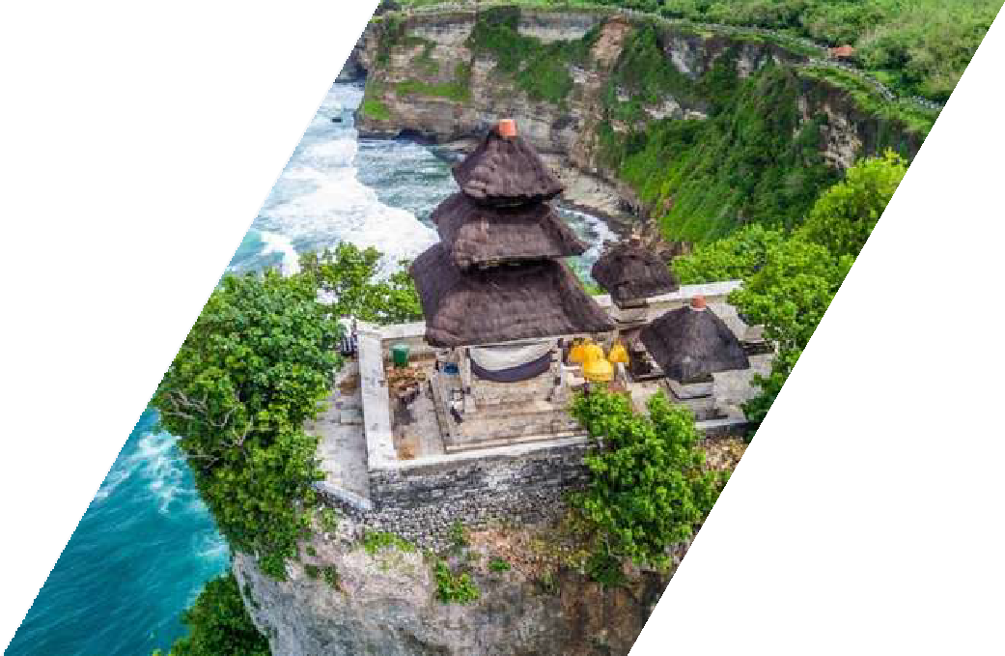

CHEAPEST
destinationglobaldmc.com
BALI TOUR PACKAGE 3 DAYS 2 NIGHTS
Experience Bali without breaking the bank with cheapest Bali tour package. Spend 3 days and 2 nights exploring the island's stunning beauty, rich culture, and vibrant nightlife. Enjoy budget- friendly accommodations, guided tours to Bali's top attractions, and unforgettable memories. Book now and embark on an affordable adventure in Bali!
DAY
1
ARRIVAL
14.00 Picked up by Tripee
14.15 Flower Goddess's Greeting
15.00 Free Time
18.00 Luch (not include)
19.30 Return to Hotel
DAY
2
ULUWATU
07.00 Breakfast at Hotel
08.00 Picked up by Tripee
09.00 Water Sports Tanjung Benoa
09.15 Free Banana Boat Ride
12.00 Lunch (not include)
14.00 Pandawa/Melasti Beach
16.30 Uluwatu Temple
18.00 Dinner at Jimbaran Seafood
19.30 Return to Hotel
DAY
3
BEDUGUL - TANAH LOT
07.00 Breakfast at Hotel
08.00 Picked up by Tripee
10.00 Taman Ayun Temple
12.15 Lunch (not include)
14.00 Ulun Danu Beratan Temple
15.30 Tanah Lot Temple
17.00 Aiport Transfer

Slide 2
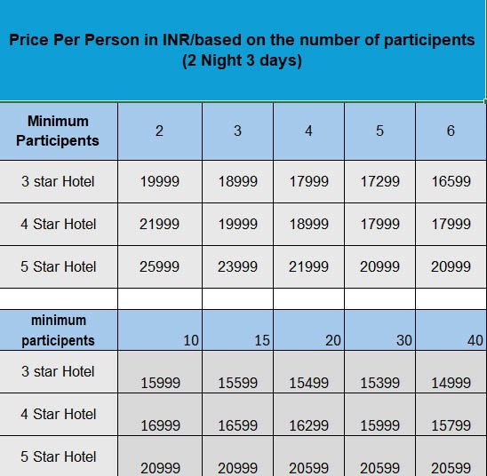

PRICE PER PERSON IN DOLLAR (USD)
BASED ON NUMBER OF PARTICIPANTS
HOTEL LIST
Star = Neo Kuta Jelantik, Boss Legian, Solaris Kuta, Siesta Legian
Star = The One Legian, Bedrock Hotel Kuta, Grand Zuri Kuta, Atanaya
Star = Arya Duta, Truntum Kuta
PACKAGE INCLUDES
Car + Driver & Fuel Driver and Guide
Tourist Attraction Entrance Ticket Parking, Tolls & Tourist Levy Welcome by Dewi Bunga
Mineral water Breakfast
Jimbaran Seafood Dinner
NOT INCLUDED
Flight ticket Personal expenses Driver Tips Insurance
Lunch and Dinner
Private Tour, not combined with other participants Event program can be tailored to your wishes Children under 3 years old are free of charge
Children aged 4-7 years are charged 90% of the adult price Additional USD 110 for professional Photo Video and Drone services Prices are valid for the Low Season period

Slide 3
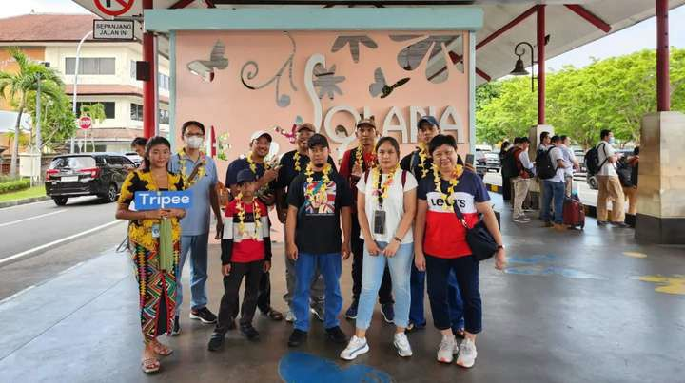
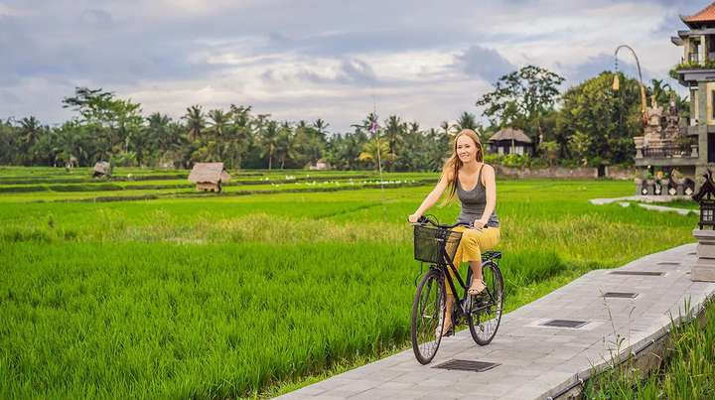
1
Event Program
DAY
Flower Goddess's Greeting
Welcome to Ngurah Rai Airport! Experience the special welcome of the Flower Goddess by tripee. The harmonious atmosphere and exclusive service create an unforgettable arrival experience. Enjoy the beauty of Bali!
Free Time
Explore your freedom in Bali! Without a fixed plan, travel anywhere. Discover the beauty of nature, explore cities, and enjoy spontaneous adventures around every corner. Unlimited freedom awaits.

Slide 4

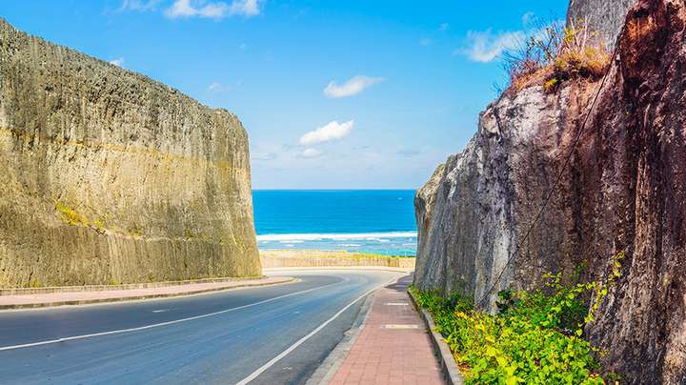
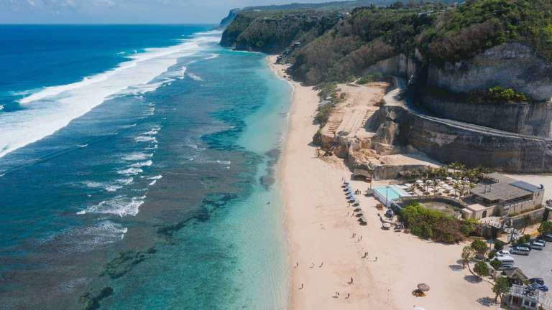
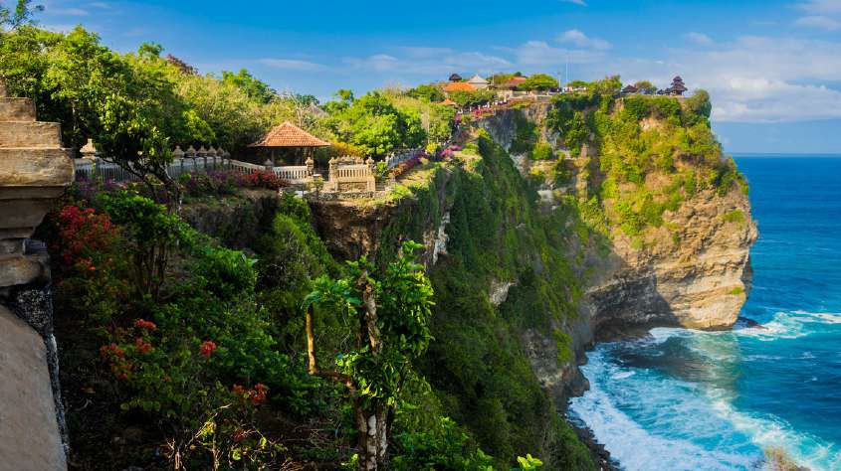
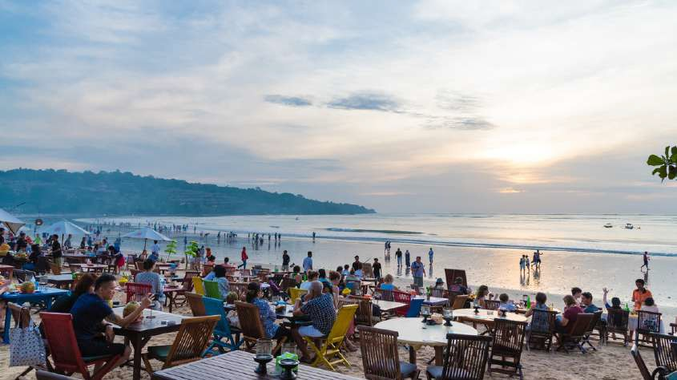
Event Program
2
DAY
Water Sport Benoa
Experience thrilling water sports in Tanjung Benoa, Bali, with activities like parasailing, jet skiing, and banana boat rides. Explore the crystal-clear waters and vibrant marine life, making your visit to Tanjung Benoa an unforgettable adventure.
Pandawa Beach
Pandawa Beach, Bali, is a stunning stretch of white sand flanked by cliffs. Crystal- clear waters invite swimming and water sports. Relax under umbrellas or explore local stalls. This peaceful paradise is perfect for a tranquil escape on the island of the gods.
Melasti Beach
Melasti Beach, Bali, offers pristine white sands, turquoise waters, and dramatic cliffs, making it perfect for relaxation and photography. Enjoy swimming, sunbathing, and exploring hidden caves. Capture stunning sunsets and witness traditional Balinese Melasti ceremonies.
Uluwatu Temple
Uluwatu Temple, perched on a cliff overlooking the Indian Ocean, is a spiritual cornerstone in Bali, Indonesia. With its stunning ocean views and Kecak dance performances at sunset, it's a must-visit for those seeking cultural immersion and breathtaking scenery.
Jimbaran Seafood
Jimbaran seafood restaurants offer a delightful experience with their fresh catches grilled over coconut husks. Enjoy the stunning sunset views as you feast on succulent seafood, including fish, prawns, and squid, accompanied by local sambal and rice.

Slide 5
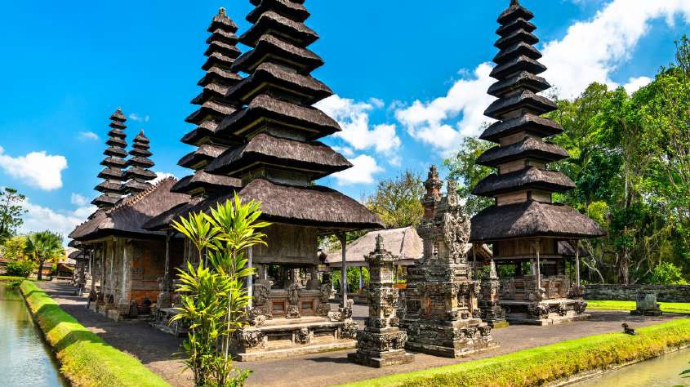

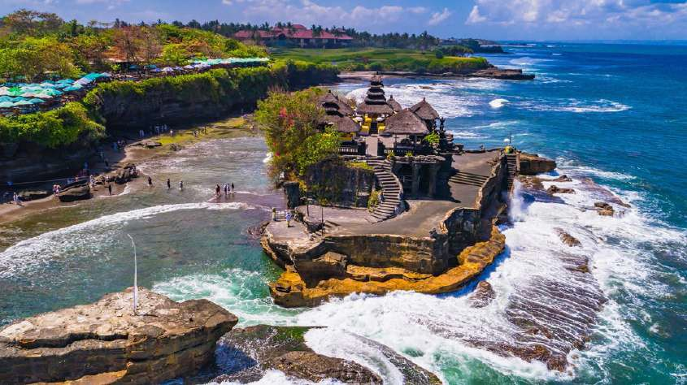
Event Program
3
DAY
Taman Ayun Temple
Taman Ayun Temple, a UNESCO World Heritage Site in Bali, Indonesia, is renowned for its stunning traditional Balinese architecture, tranquil gardens, and expansive moat. It's a cultural gem, offering visitors a serene and picturesque glimpse into Bali's rich heritage.
Ulun Danu Beratan Temple
Pura Ulun Danu Beratan, a majestic water temple in Bali, sits serenely on Lake Beratan's shores. Its iconic multi-tiered shrines are set against the backdrop of the scenic Bedugul mountains, creating a breathtaking sight and a spiritual haven for visitors seeking tranquility and cultural immersion.
Tanah Lot Temple
Tanah Lot Temple, a sacred sea temple in Bali, Indonesia, offers stunning ocean views and mesmerizing sunsets. Built on a rock formation, it is a popular tourist destination and a symbol of Balinese spirituality and cultural heritage.

